Slide 1
NextHikes IT Solutions - Project 1
Bike Sharing Demand Analysis Project Using Excel

Slide 2
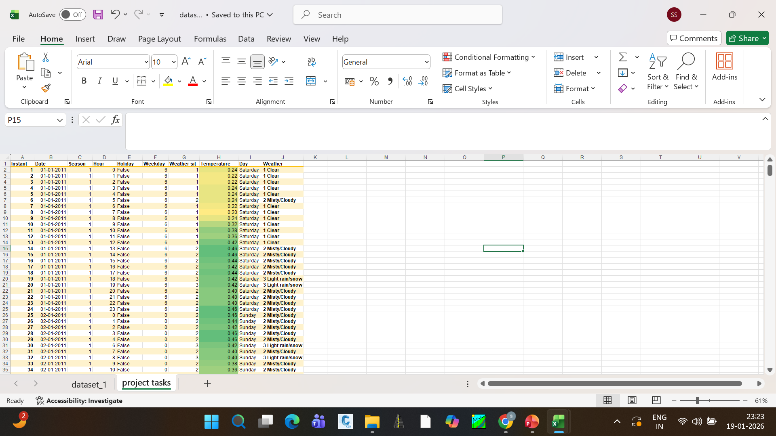
Excel Foundations & Data Handling
Step 1: Data Setup Open the Excel sheet and select the entire data (Ctrl + A).
Go to Home > Format as Table and apply any table style to convert the data into a table.
Make all headers bold: instant, dteday, season, yr, mnth, hr, holiday, weekday, weather sit, temp, atemp, hum, windspeed, casual, registered, cnt
Fix the date format: Select the dteday column , Go to Data > Text to Columns > Delimited > Finish
Step 2: Clean and Filter Data
Turn on filters: Data > Filter or Ctrl + Shift + L
Remove blanks : Click the filter drop-down, Uncheck Blanks
Date Only Use the formula:=IFS(G2=1,"1 Clear",G2=2,"2 Misty/Cloudy",G2=3,"3 Light rain/snow",G2=4,"4 Heavy rain/snow")

Slide 3
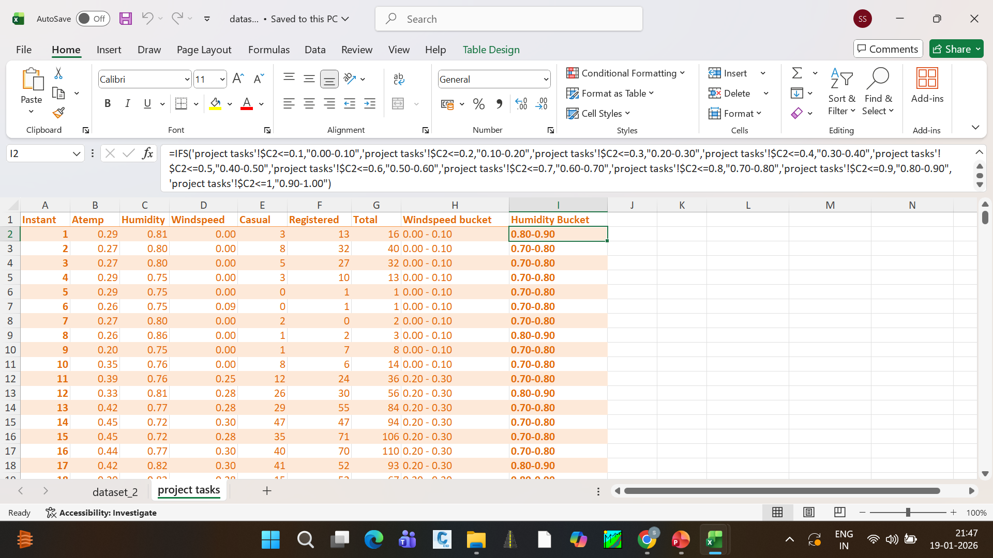
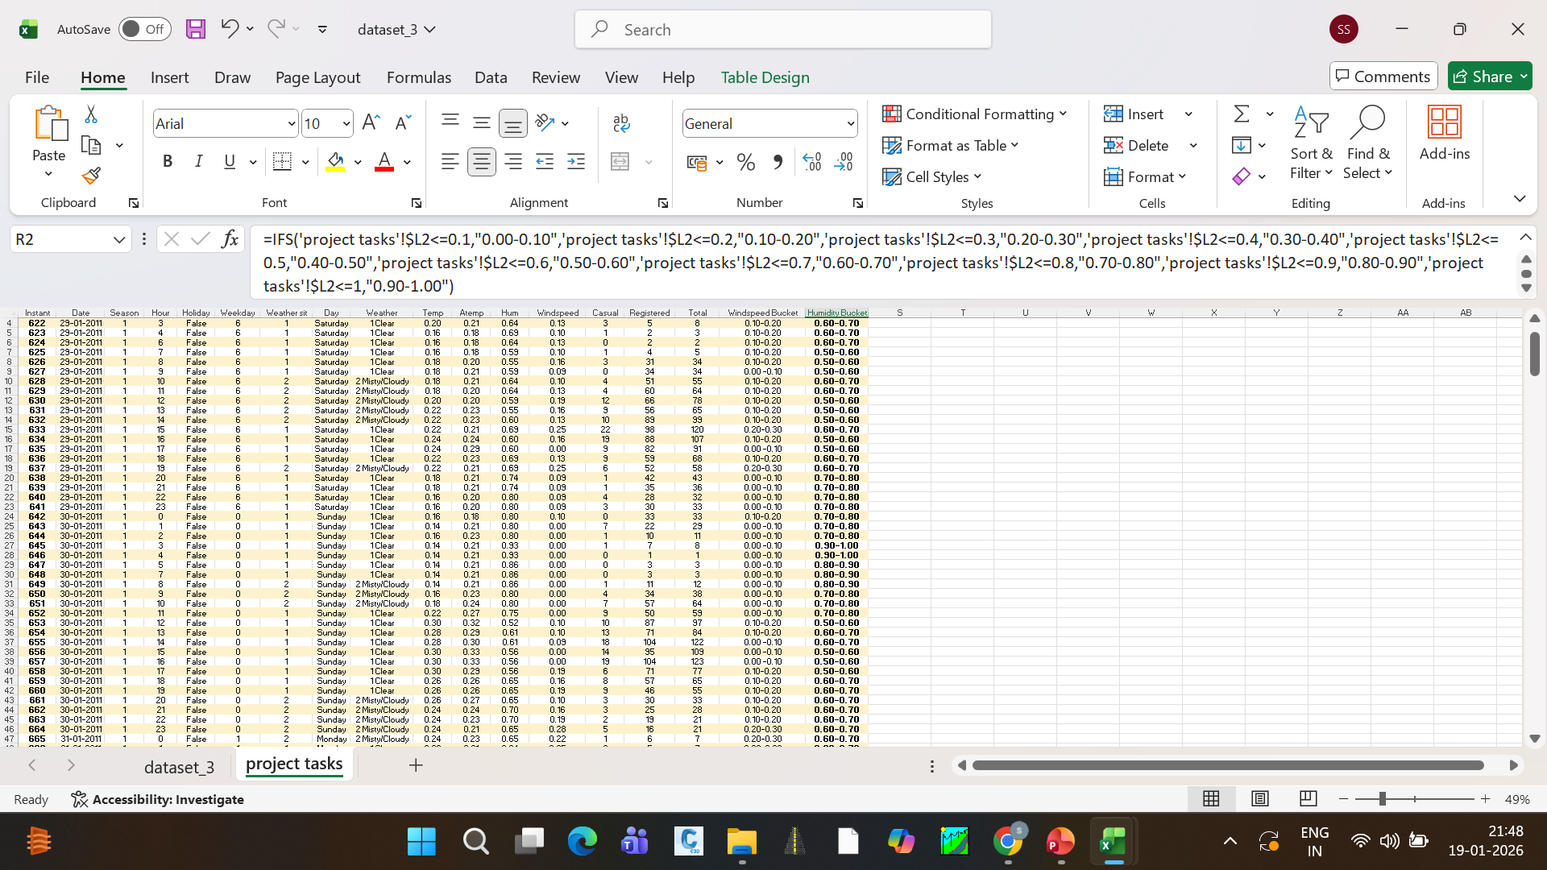
Dataset_2 and Dataset_3
How it works:
1
Data cleaning means correcting or removing incorrect, incomplete, duplicate, or irrelevant data so that the dataset becomes accurate and ready for analysis.
2
Examples of Data Cleaning: Removing blank cells Fixing wrong date formats Removing duplicate rows Converting text numbers into numeric values Handling missing values (delete or replace)
Data filtering means showing only the required data and hiding the rest based on a condition.
3
4
Examples of Data Filtering: Show only Holiday = TRUE, Show rentals greater than 500, Show data for Summer season, Show top 10 values of cnt, In Excel, how to apply Filter: Select header row Press Ctrl + Shift + L, Use dropdown arrows to filter data

Slide 4
DATASET 1,2 & 3 INFORMATION
Step 1: Data Setup Open the Excel sheet and select the entire data (Ctrl + A).Go to Home > Format as Table and apply any table style to convert the data into a table. Make all headers bold: instant, dteday, season, yr, mnth, hr, holiday, weekday, weathersit, temp, atemp, hum, windspeed, casual, registered, cnt Fix the date format : Select the dteday column Go to Data > Text to Columns > Delimited > Finish
Step 2: Clean and Filter Data Turn on filters: Data > Filter or Ctrl + Shift + L Remove blanks: Click the filter drop-down Uncheck Blanks Sort data by cnt in descending order: Data > Sort > cnt (Largest to Smallest)Filter holiday = TRUE to analyse rental behaver on holidays (rentals are usually lower). Clean text data: Create a new column named Date Only Use the formula:
Step 3: Apply Basic Formulas Total Rentals:=SUM, Average Temperature:=AVERAGE Maximum Hourly Rentals:=MAX Count of Non-Holidays:=COUNTIF
Step 4: Conditional Formatting Select the temp column: Go to Home > Conditional Formatting > Color Scales Apply Green–Yellow–Red scale Higher temperature values (>0.4) will appear in green

Slide 5
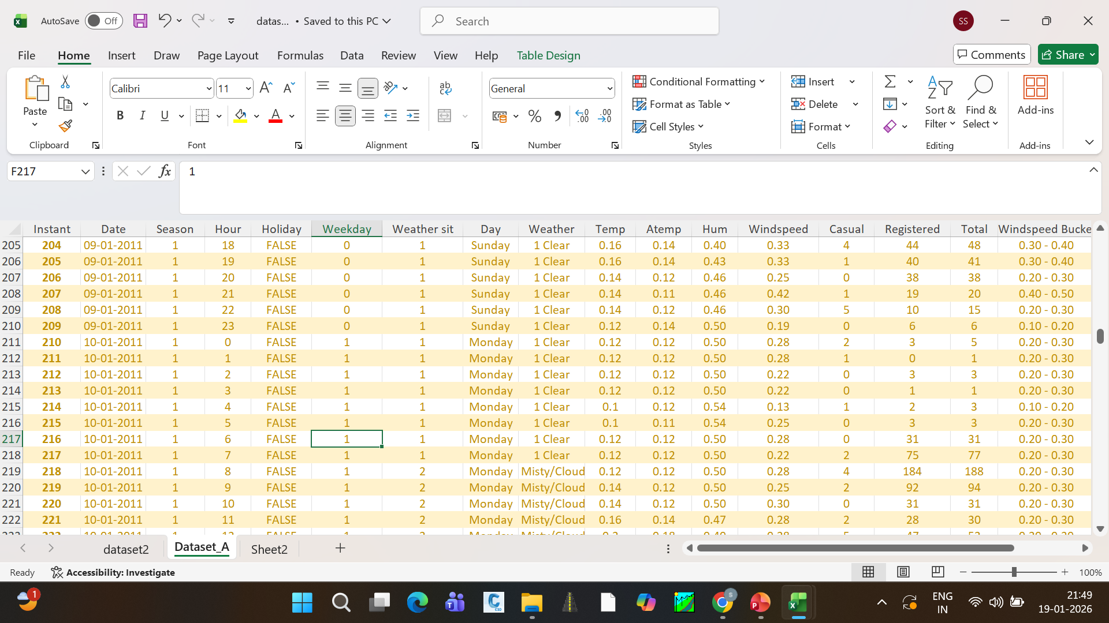
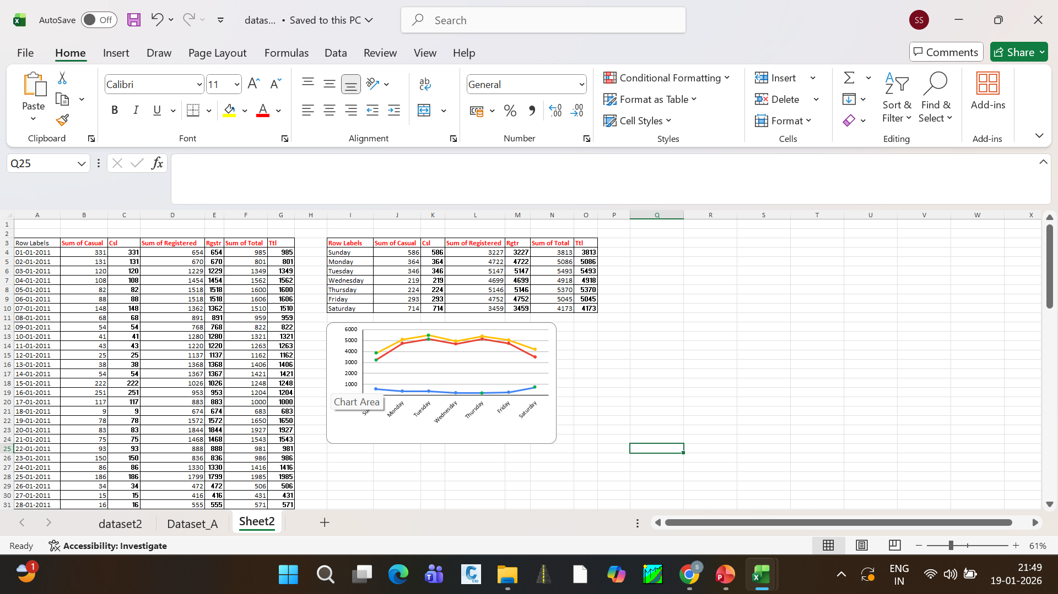
Merge dataset_1 and dataset_2
Steps: Go to Data > Get Data > From Table/Range (Dataset 1)
Load Dataset 2 same way
In Power Query: Home > Merge Queries
Select common column from both datasets Choose join type: Inner Join → matching data only Left Join → all from Dataset 1 Right Join → all from Dataset 2 Full Join → all data Click OK → Expand columns → Close & Load

Slide 6
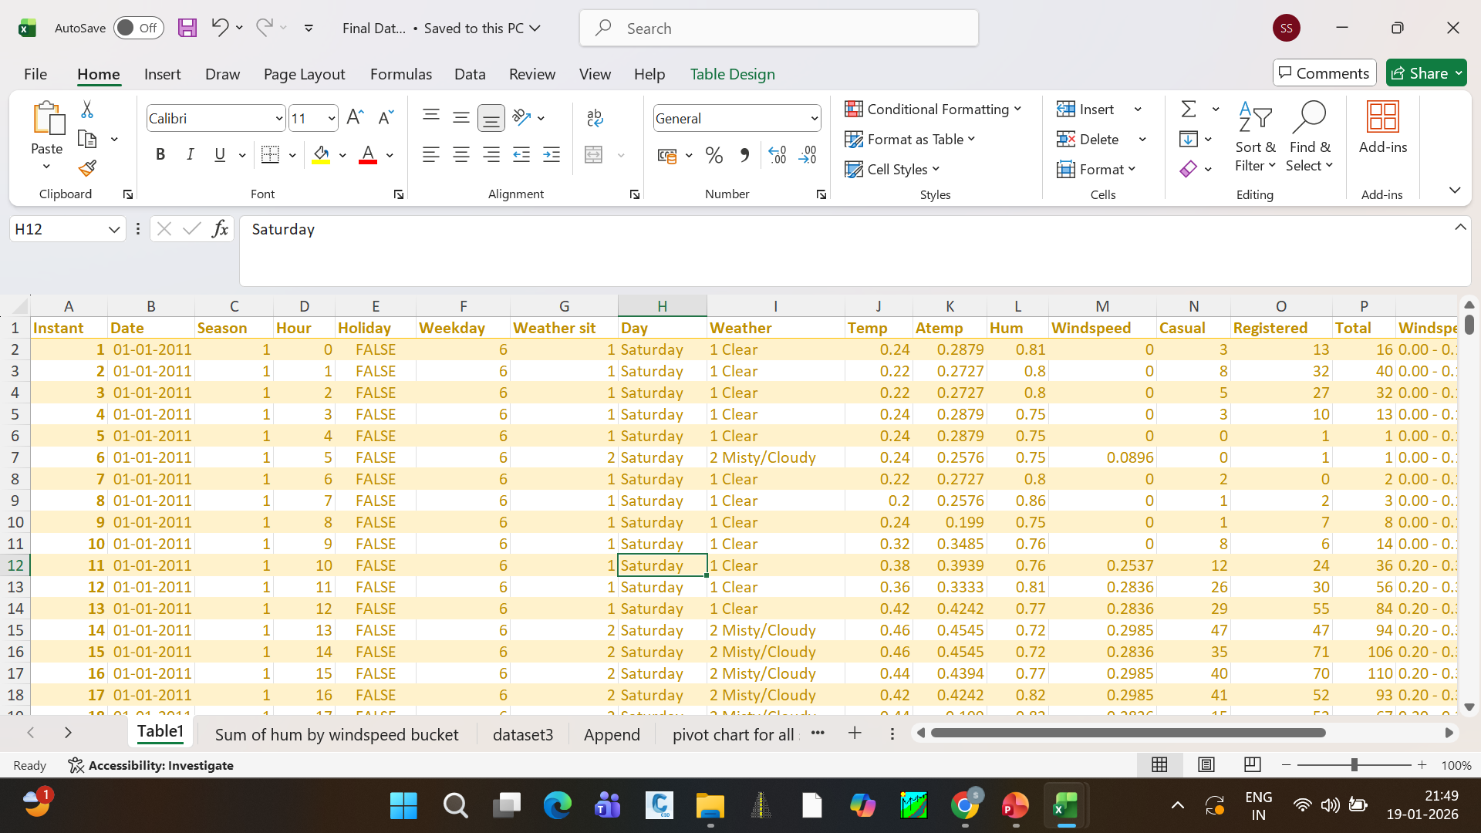
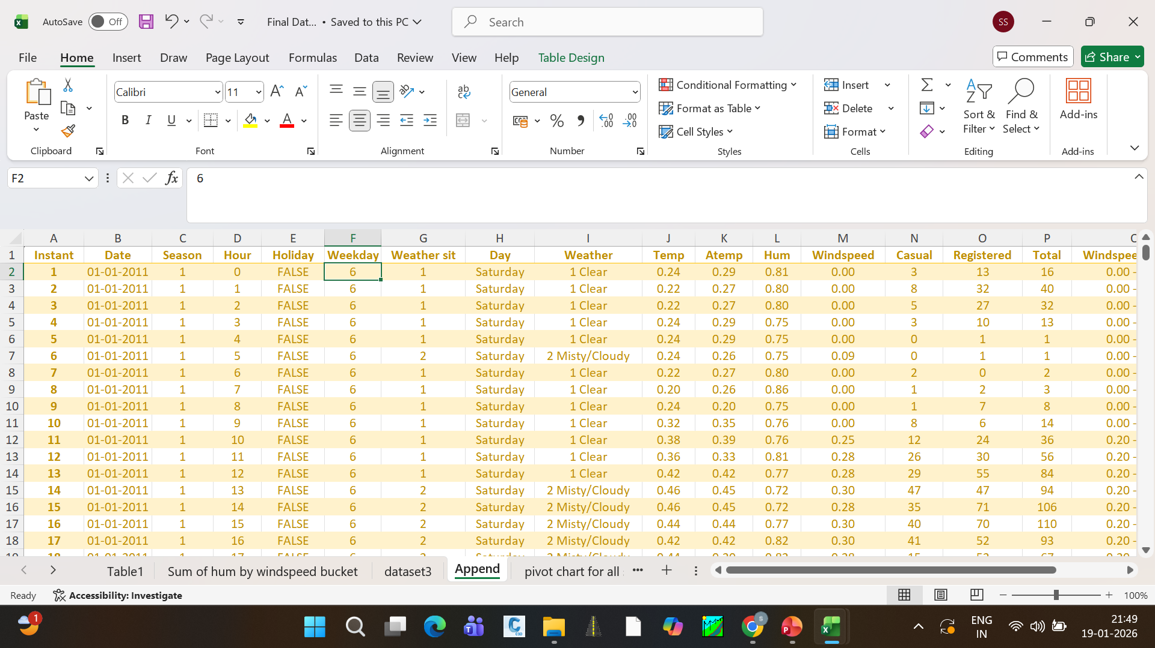
FINAL DATASET
1
AFTER MERGING DATASET_1 AND DATASET_2,AND THAN WE HAVE DATASET_A
2
AFTER THAT, WE MERGED DETASET_A WITH DATASET_3
3
AFTER THAT,WE OBTAINED THE FINAL DATASET

Slide 7
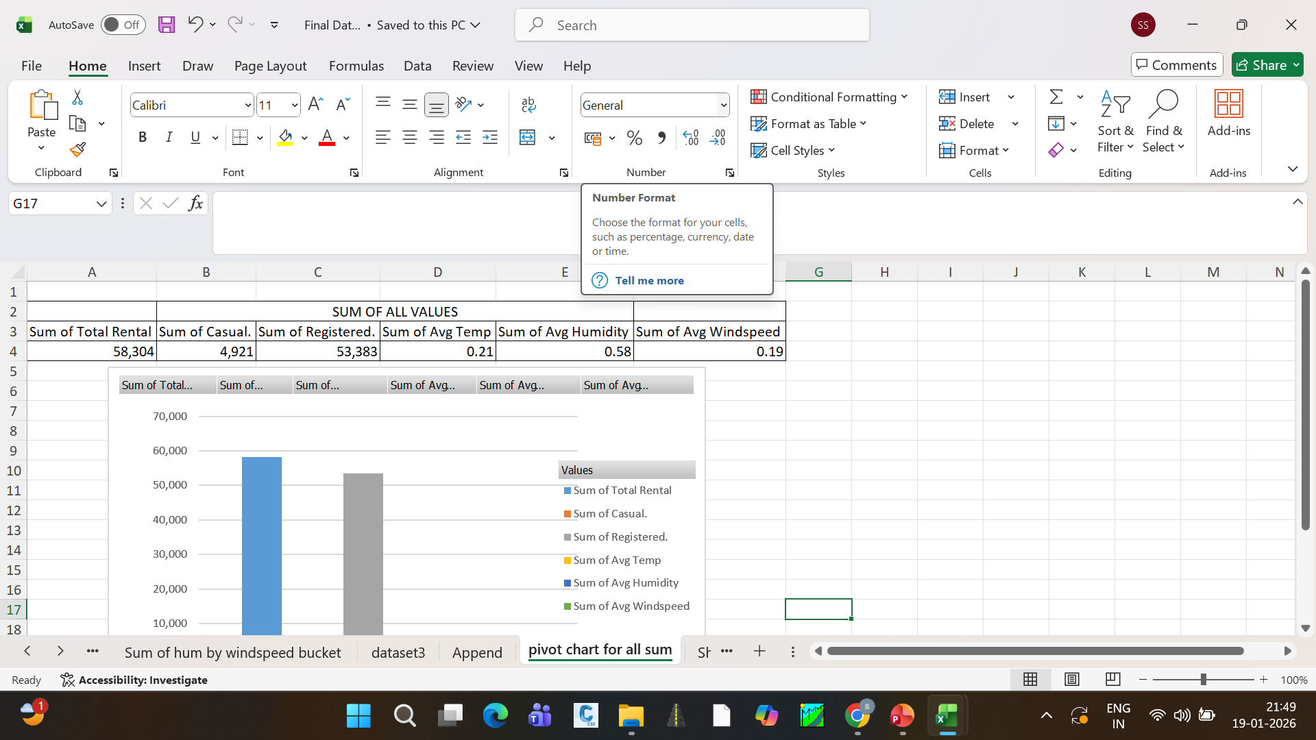
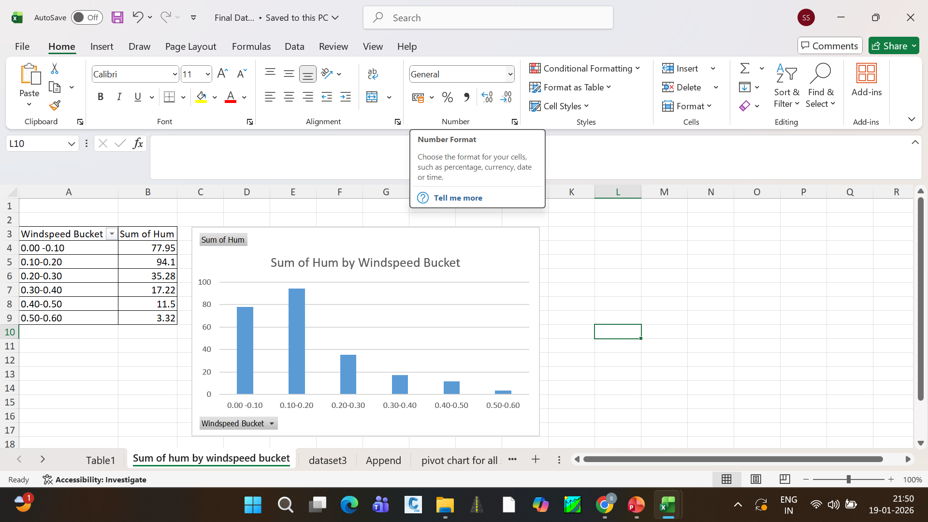
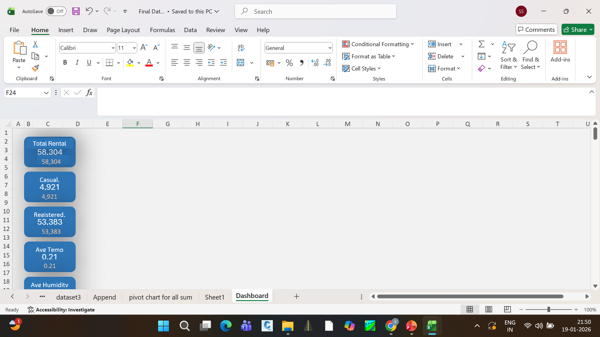
Final Dashboard
1
A Final Dashboard is a visual summary of the complete analysis.
2
It displays key results and insights on one single screen.
3
The dashboard is created using the final cleaned and merged dataset. It includes charts, pivot tables, and key metrics

